Slide 1
Foundations of Vision and Language
POS tagging and Syntactic Analysis
Sidharth Ranjan

Slide 2
Outline
POS tagging
Linguistic Structure
  Constituency Formalism
  Dependency Formalism
Syntactic Analysis

Slide 3
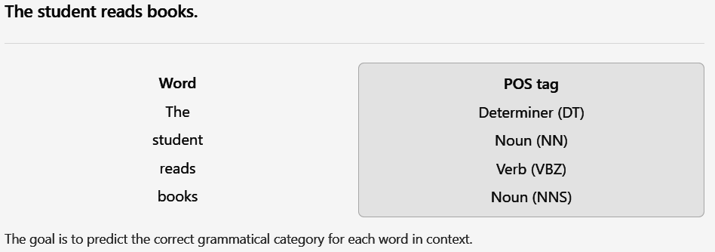
What is POS tagging?
Task of assigning a grammatical category to each word in a sentence.

Slide 4
POS tagging
Observed word (w) | POS tag (t)
Dogs | Noun
chase | Verb
cats | Noun
Tagging ambiguity
  I read a book
    Here, book is a noun
  Please book a ticket.
    Here, book is a verb
Problem Statement
  Data is available in the format (w, t),
    w = observed data, such as words in a sentence
    t = classes, such as POS tags
Supervised Setting:
  Training: Words and their correct POS tags pair (w, t)
  Testing: A new sentence and ask the model to predict its tags
  So POS tags (t) are hidden or unknown for the sentence being tagged

Slide 5
Sequence Tagging
Part of speech (POS) tagging is a type of sequence tagging
  It assigns grammatical categories such as nouns, verbs, adjectives, and adverbs etc to each word in a text based on its definition and context
  Given a sequence of observations, the POS tagger assigns a label/class to each item in the sequence
This helps machines to understand sentence structure and word relationships, essential for varieties of NLP tasks like MT, IE, Understanding
The difficulty is that the same word can have different POS tags depending on its use. Thus, resolving lexical ambiguity is an important aspect of this task
British Left Waffles on Falkland Islands

Slide 6
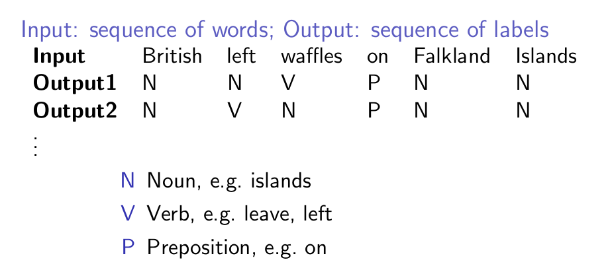
Each of the part of speech tags represent states
A noun state goes to another noun state, followed by a verb etc.
Each of these states is mapped to a sequence of observations
In this case, we are doing a type of sequence prediction, mediated by the POS tags

Slide 7
Types of POS tagger
Rule-based or Look-up Tagger
  Regular expression tagger
  Default taggers & N-gram Taggers
Statistical Tagger
  Generative Tagger: HMM
  Discriminative Tagger: Maximum Entropy Tagger
Neural Tagger
  BiLSTM taggers
  Transformer-based models (e.g., BERT, spaCy's pipelines, or Stanza)

Slide 8

Generative Model
A generative model learns how likely a sequence of POS tags is and how likely words are given those tags
  It learns that a noun is likely to generate words such as student, dog, or book, while a verb may generate words such as read, run, or eat.
Objective: How words and tags are jointly generated?
Mathematically, it models the joint probability: P(W, T), where the main question is how likely are these words and tags together?
And then to tag a sentence, it finds the most probable tag sequence:

Slide 9

Discriminative Model
A discriminative model directly learns how to predict the POS tags from the observed words and their context
  It learns that reads is likely to be a verb in the sentence: The student reads books.
Objective: How to predict tags from words?
Mathematically, it models the conditional probability: P(T | W), where the main question is given these history of words, which tags are most likely?
And then it predicts the tag sequence with the highest conditional probability :

Slide 10
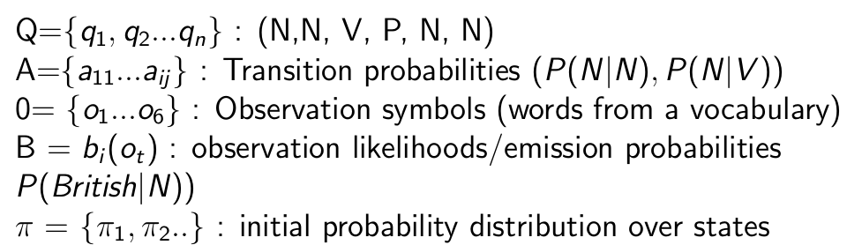
Hidden Markov Model (Generative Approach)
We can model the POS tagging problem with the words as the seen (observable) events and tags that are the hidden events
A hidden Markov model allows us to create a probabilistic model that contains both observed events and hidden events

Slide 11
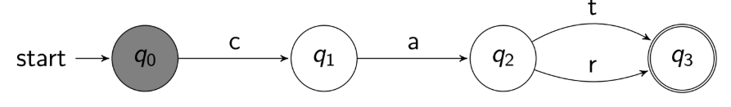
Finite State Automaton (FSA)
Each FSA is a five-tuple consisting of alphabet symbols (Σ), set of states (Q), an initial (q₀) and final state (F), a transition function (δ) showing a relation from states to alphabet symbols to states
FSA: A = < Q, Σ, q₀, δ, F >
where Q = {q₀, q₁, q₂, q₃},
Σ = {c, a,t, r},
F= {q₃}, and
δ = {< q₀, c, q₁ >, < q₁, a, q₂ >, < q₂,t, q₃ >, <q₂, r, q₃ >}

Slide 12
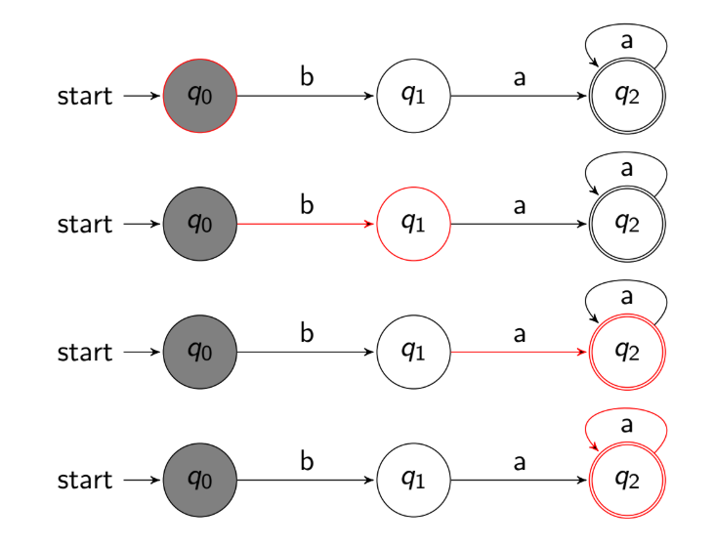
Recognizing sheep language baaa

Slide 13
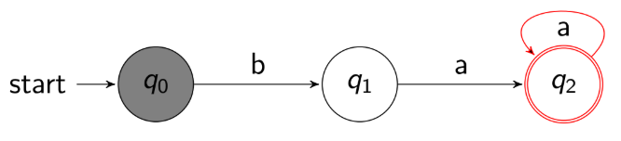
At this point, we have reached the accept state at the end of the string

Slide 14
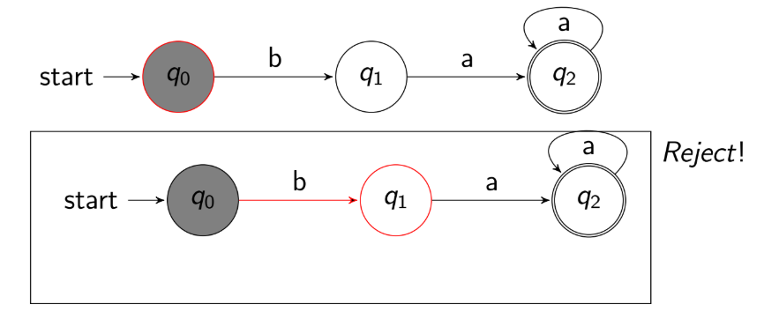
For bb: no accepting state
It will reject the string, because q1 is not a final state.

Slide 15
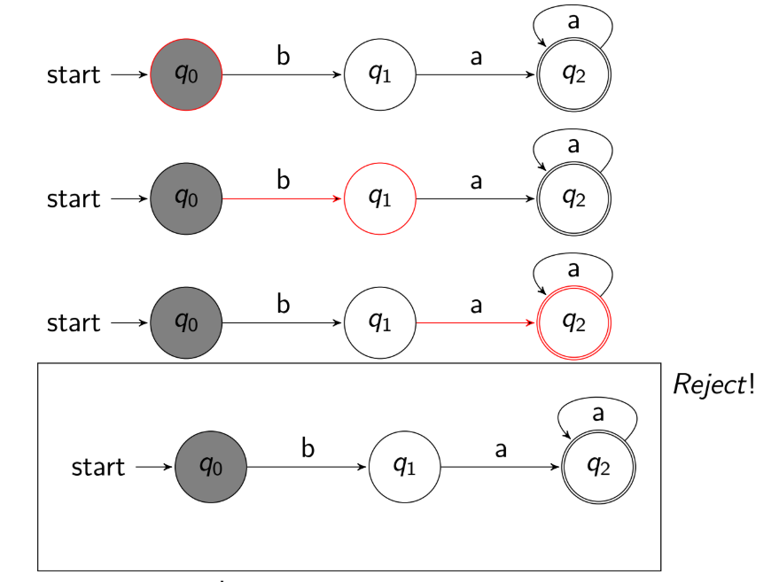
Transition not defined bac

Slide 16
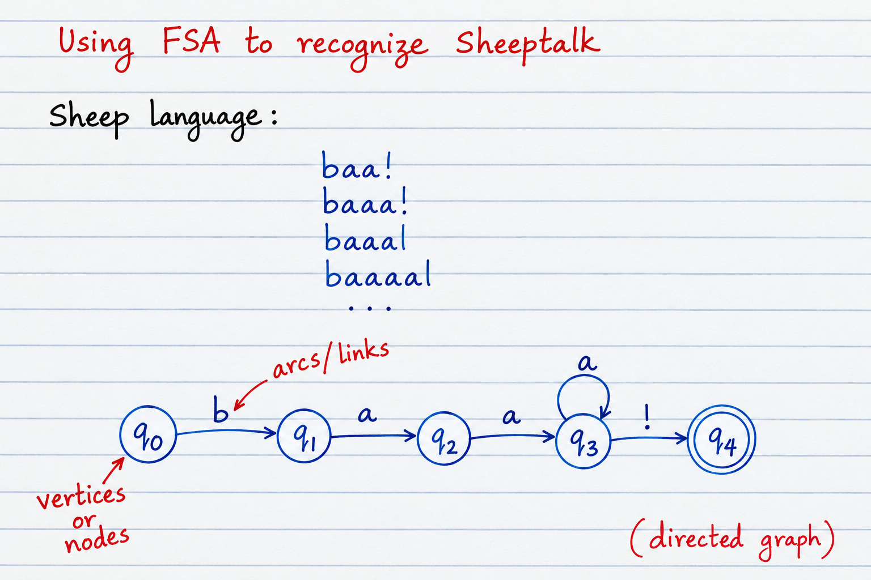

Slide 17
Hidden Markov Model (Generative Approach)
A hidden Markov model allows us to create a probabilistic model that contains both observed events and hidden events

Slide 18
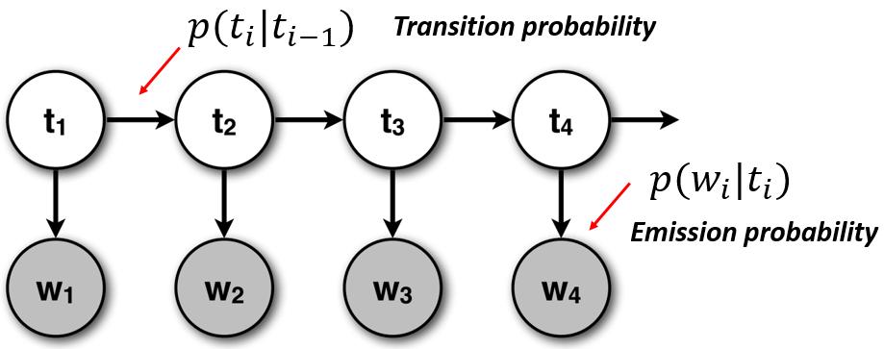

Slide 19
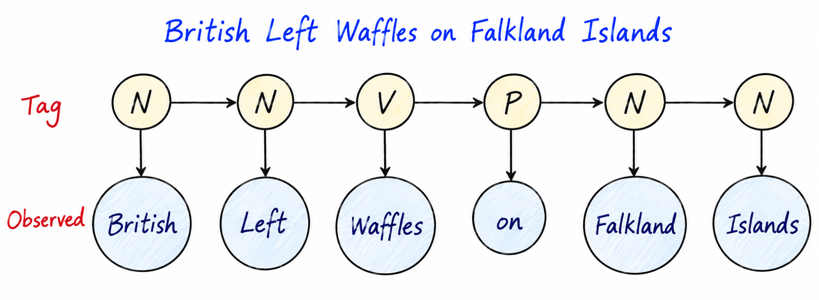

Slide 20
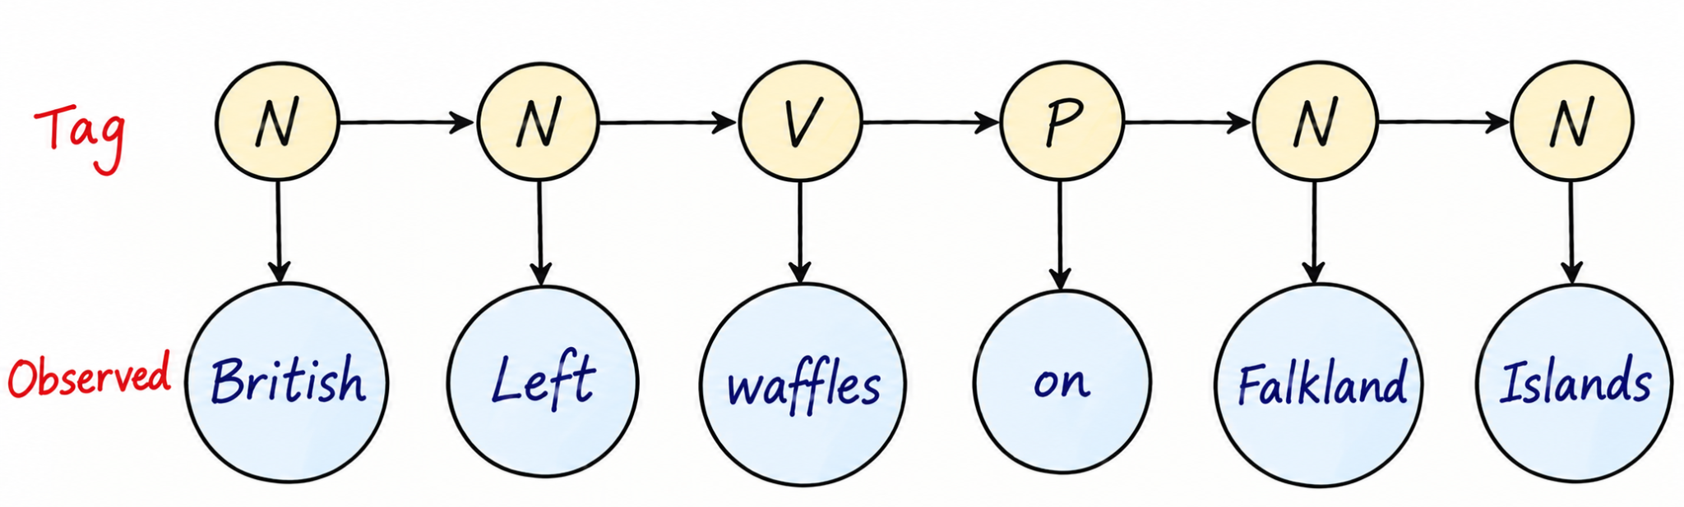
Ngrams vs HMMs
S = British Left Waffles on Falkland Islands
Bigram model (n-gram)
  P(British) . P(Left | British) . P(Waffles | Left) . P(on | Waffles) . P(Falkland | on) . P(Islands | Falkland)
  N N V P N N
    P(N) x P(N|N) x P(V | N) x P (P |V) x …
    P (British | N), P (Left | N), P (Waffles | V),
HMM
  P(N) P(British | N) P(N | N) P(Left | N) P(V | N) P(Waffles | V) P(P | V) P(on | P) P(N | P) P(Falkland | N) P(N | N) P(Islands | N)

Slide 21
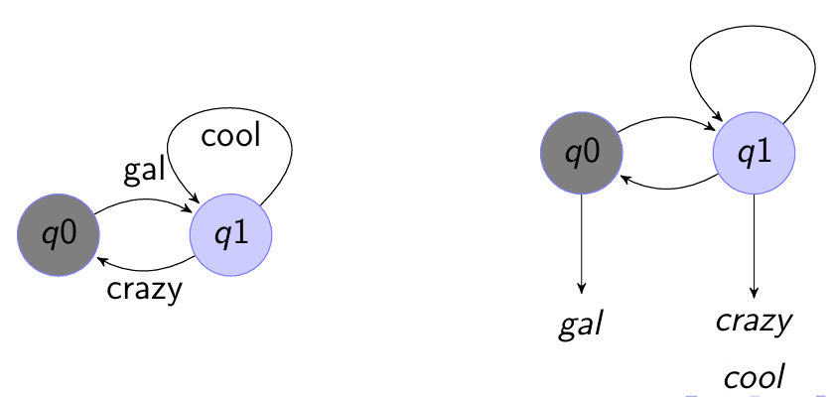
Two types of finite state machines
The first associates an output value with each transition edge
The second associates an output value with each state
Both representations are equivalent, but we will use the second for HMM problem

Slide 22
Probabilistic FSM
HMM is a probabilistic form of the Moore machine (type of FSA)
Start at a state i with a start state π_{i}
Transition from state i to state j denoted by transition probability P(j | i) e.g (P(N | N))
Emission of symbol (word) o from state i has an emission probability P(o | i) e.g (P(British | N))
All outgoing transition arcs from a state must sum to 1
All symbol emissions from a state must sum to 1

Slide 23
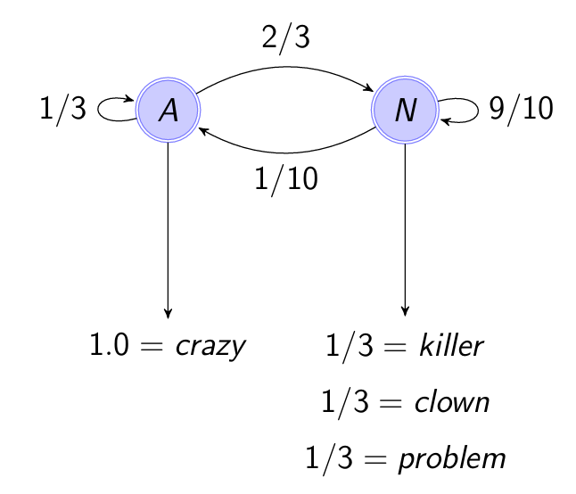
All symbol emissions from A and N sum to 1
All outgoing transition arcs from A and N sum to 1
Valid transition probability and valid emission probability
P (A | A) = ⅓
P (N | A) = ⅔
P (A | N) = 1/10
P (N | N) = 9/10 = 0.9

Slide 24
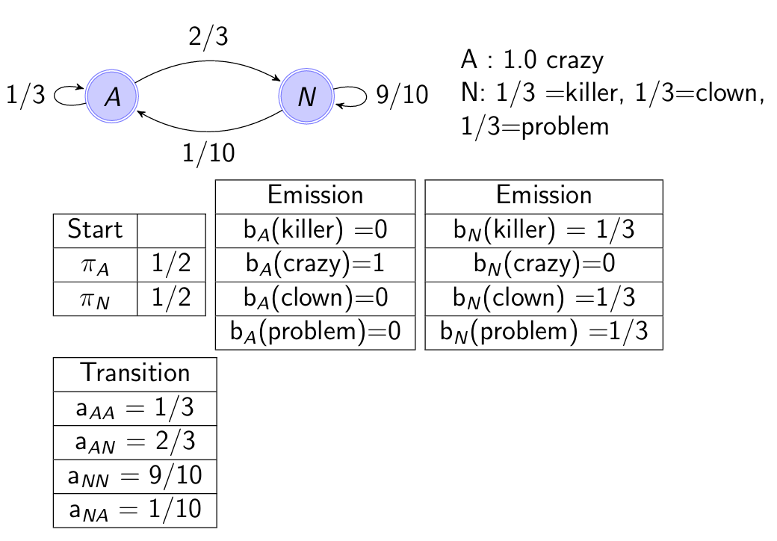

Slide 25
HMM Parsing
HMM as parser: Compute the best sequence of states for a given observation sequence
Given an ambiguous sequence, we get the correct sequence of tags that describes it
Once we have obtained the table of emission and transition probabilities and the start probabilities, this is straightforward

Slide 26
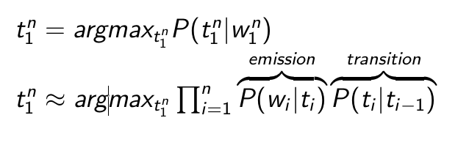
Task
For a given observation sequence O=(o₁ ...o_{t}...o_{T}), find the most likely state sequence i.e. sequence of tag states
Learn from a set of observations with the sequence of states provided (i.e already tagged data)
Once learnt, HMM as parser compute the best sequence of states for a given observation sequence

Slide 27
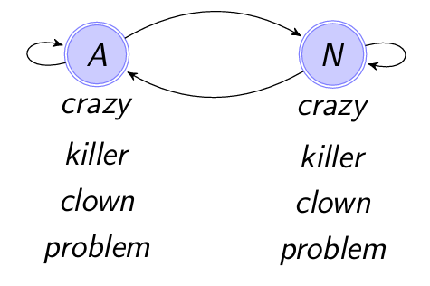
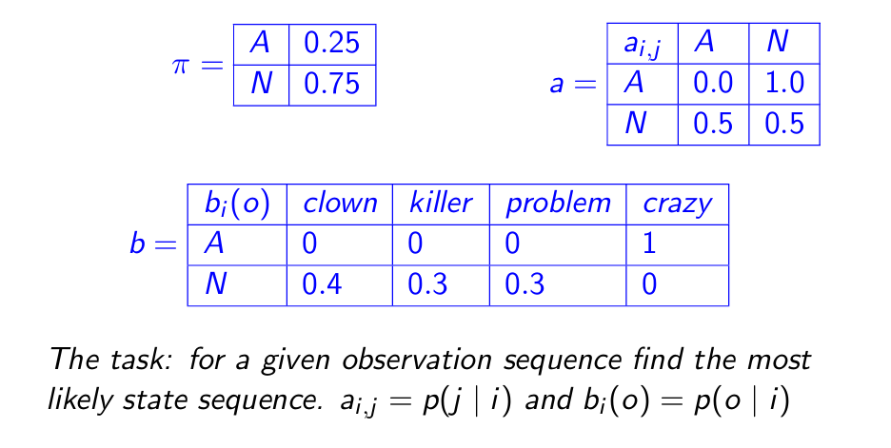

Slide 28
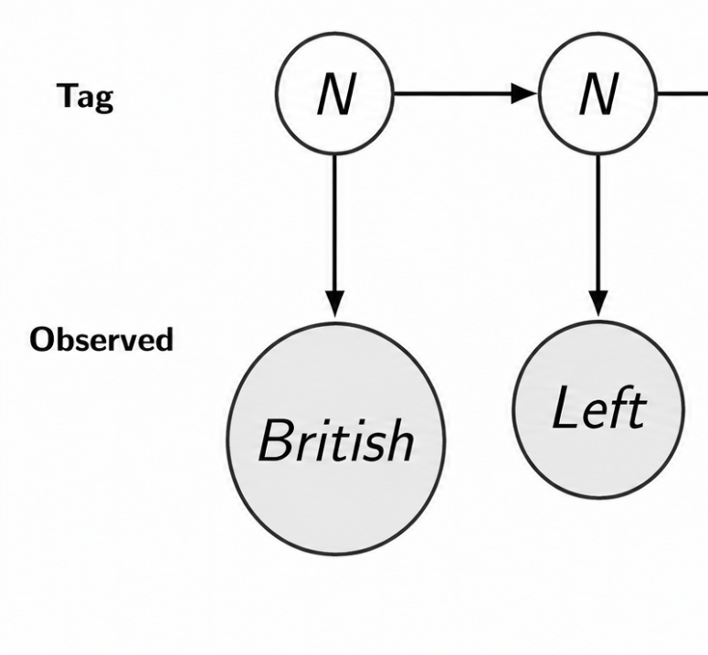
Probability Estimation
S₁ = (British Left, NN)
P(S₁) = P(N) P(British | N) P(N | N) P(Left | N)
S₂ = (British Left, NV)
P(S₂) = P(N) P(British | N) P(V | N) P(Left | V)
P(S₂) > P(S₁)
AA, AN, NA, NN
S = (Killer Clown, AA)
P(S) = P(A) P(Killer | A) P(A | A) P(Clown | A)
P(S) = π x b_{A}(killer) x a _{A,A} x b_{A}(Clown) = 0.25 x 0 x 0 x 0 = 0
S = (Killer Clown, NN)
P(S) = P(N) P(Killer | N) P(N | N) P(Clown | N) = 0.25 x 0.3 x 0.5 x 0.4 = 0.045

Slide 29
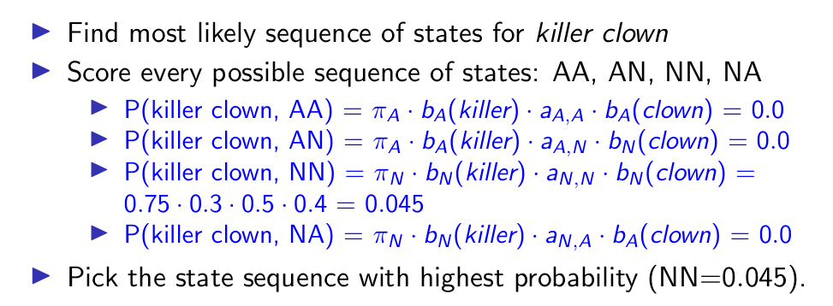
Sequence of states for “killer clown”

Slide 30
Most likely path sequence
For an input of length 2 and a HMM with 2 states there are 2² possible state sequences
If we have q states and input of length T, there are q^{T} possible sequences. For killer crazy clown problem with only 2 states (A,N) we have 2⁴ sequences to score (and so on..)
Brute force approach will be to check all the q^{T} possible sequences. So this approach will take exponential time to find the best state sequence
Instead the Viterbi algorithm that uses dynamic programming is used to solve for the best state sequence

Slide 31
Other types of taggers
Perceptron tagger based on a different principle (error-driven learning) is also very effective for POS tagging
Rather than look at a word and its most recent history, the perceptron tagger will try to generate the most likely tag sequence for the entire sequence (sentence)
This has some advantage over the process of tagging one word at a time, and also gives access to phenomena that might be distantly related
Newer sequence tagging neural models (RNNs) have been shown to be very effective at sequence tagging

Slide 32
Chunking: Sequence labelling
Find and classify spans of text using IOB encoding (Inside Outside Begin)
Spans can correspond to regions of interest, such as constituents (chunks) or other types of spans e.g. named entities
  We PRP B-NP
  saw VBD B-VP
  the DT B-NP
  yellow JJ I-NP
  dog NN I-NP
  . PUNC O
_{NP}[We _{VP}[saw _{NP}[the yellow dog]]].

Slide 33
Named Entity Tagging using IOB encoding
United B-ORG
cancelled O
the O
flight O
from O
San B-LOC
Francisco I-LOC
[United] cancelled the flight from [San Francisco].

Slide 34
Chunking
Chunking usually selects a subset of the tokens
Chunking algorithms vary from regex chunkers, n-gram chunkers (use tag patterns), classifiers (using both tag and word information)
NE recognition where Organization, Person, Date, Location etc are tagged also make use of classifiers or neural sequence taggers

Slide 35
POS Tagging (In-Class Activity-3)
Please submit in Google Classroom!
Deadline: TBD
Link: https://drive.google.com/drive/folders/1B1iGYnJ_LGkUGk15DcpTKzldo03muqId?usp=sharing

Slide 36
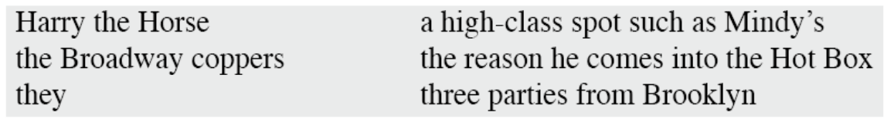
Linguistic Structure
Constituent or Phrase
  The basic idea here is that groups of words within utterances can be shown to act as single units – Constituent or Phrase
  For example, it makes sense to the say that the following are all noun phrases in English

Slide 37
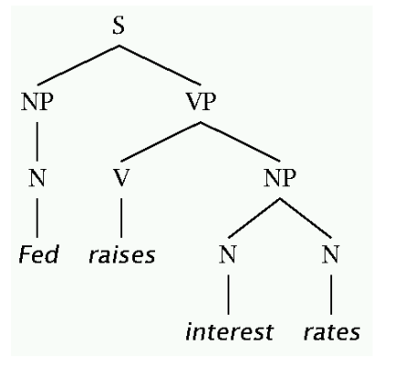
Constituency Structure
Phrase structure organizes words into nested constituents
  How do we know what is a constituent?
A constituent behaves as a unit that can appear in different places
  John talked [to the children] [about drugs]
  John talked [about drugs] [to the children].
  *John talked drugs to the children about.
Phrase structure tree
  VP → … VB* …
  NP → … NN* …
  ADJP → … JJ* …
  ADVP → … RB* …
  PP → … IN* …
Bracket notation of a tree (Lisp S‐structure):
(S (NP (N Fed)) (VP (V raises) (NP (N interest) (N rates)))

Slide 38
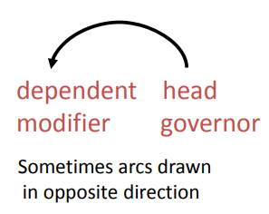
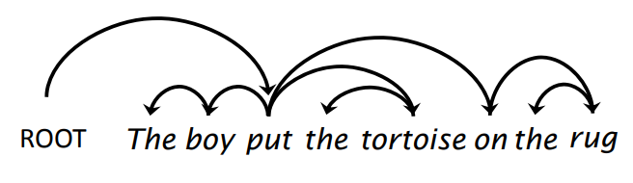
Dependency Structure
In CFG‐style phrase‐structure grammars the main focus is on constituents
But it turns out you can get a lot done with binary relations among the lexical items (words) in an utterance
In a dependency grammar framework, a parse is a tree where:
  The nodes stand for the words in an utterance
  Links between the words represent dependency relations between pairs of words
  Relations may be typed (labeled), or not

Slide 39
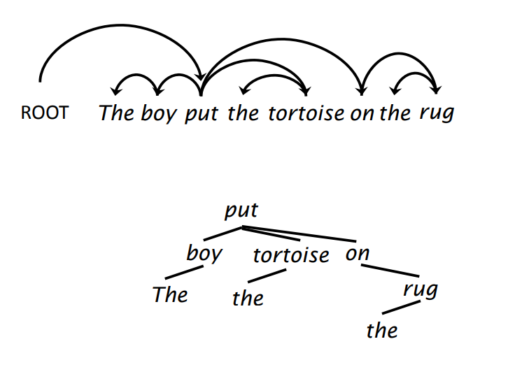
Alternative notation

Slide 40
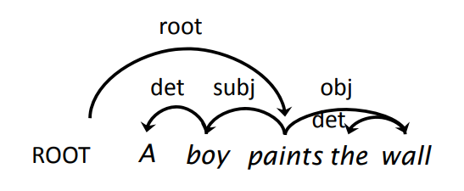
Dependency Labels
Argument dependencies:
  Subject (subj), object (obj), indirect object (iobj)…
Modifier dependencies:
  Determiner (det), noun modifier (nmod), verbal modifier (vmod), etc.

Slide 41
Summary
Dependency structures explicitly represent
  head‐dependent relations (directed arcs)
  functional categories (arc labels)
  Universal Dependency Treebank: https://universaldependencies.org/
Phrase structures explicitly represent
  Phrases (nonterminal nodes)
  Structural categories (nonterminal labels)
  Functional categories (grammatical functions)
  Leaf nodes (word)
  Constituency Treebanks: Penn Treebank Corpus (https://www.nltk.org/howto/corpus.html)
One morning I shot an elephant in my pajamas.

Slide 42
Summary
Dependency structures explicitly represent
  head‐dependent relations (directed arcs)
  functional categories (arc labels)
  Universal Dependency Treebank: https://universaldependencies.org/
Phrase structures explicitly represent
  Phrases (nonterminal nodes)
  Structural categories (nonterminal labels)
  Functional categories (grammatical functions)
  Leaf nodes (word)
  Constituency Treebanks: Penn Treebank Corpus (https://www.nltk.org/howto/corpus.html)
One morning I shot an elephant in my pajamas.
How he got into my pajamas, I’ll never know

Slide 43
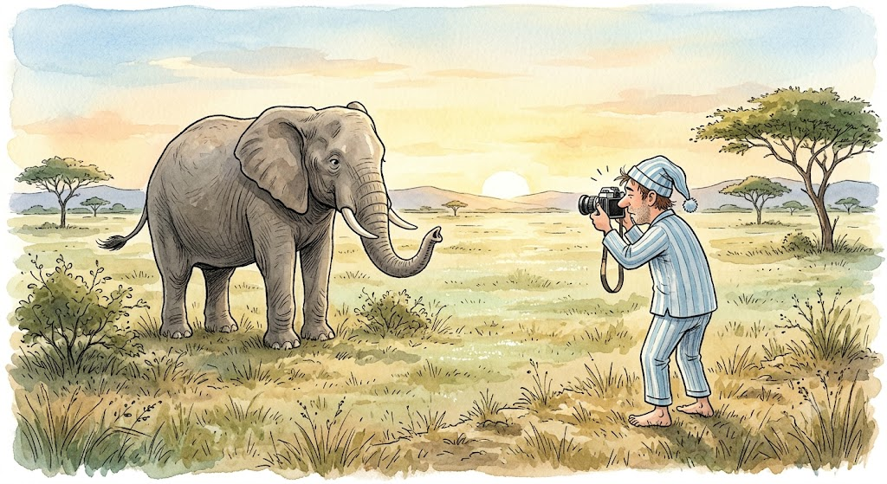
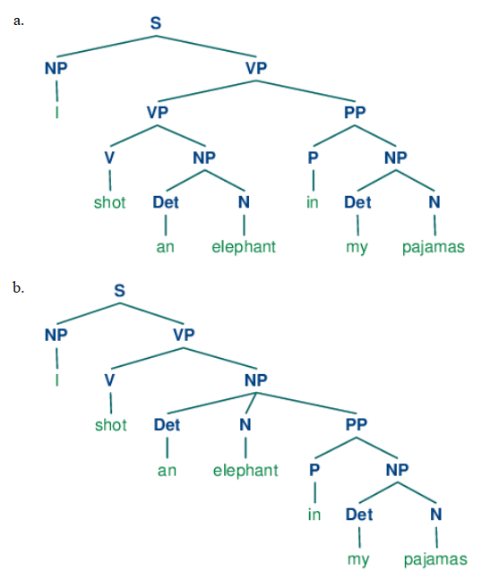
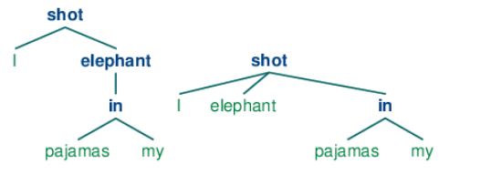
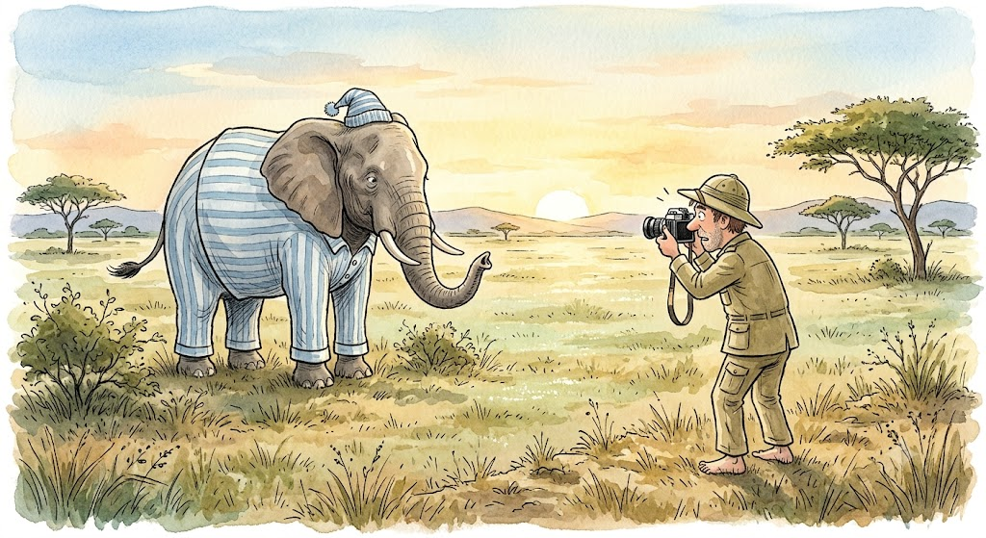
Attachment Ambiguity
Credits: Gemini

Slide 44
Tools
https://www.nltk.org/book/
https://spacy.io/usage/linguistic-features#named-entities
https://stanfordnlp.github.io/stanza/neural_pipeline.html

